Slide 1
TPOT’s performance for Biomedical Data
Tim Beishuizen
Supervisor: Joaquin Vanschoren

Slide 2

Introduction
Computational Biology
  Data analysis framework
Content
Biomedical Data
  Bariatric dataset
Automated Machine learning
  TPOT
TPOT’s performance for Biomedical Data

Slide 3
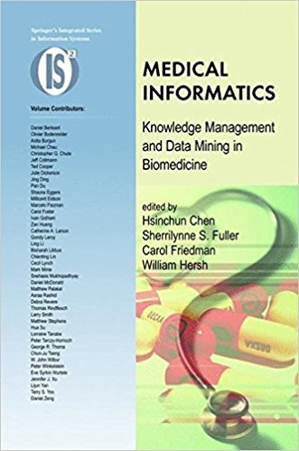
Biomedical
Data
Challenges
  Volume
  Dimensionality
  Complexity
  Heterogeneity
  Quality
Chen, Hsinchun, et al., eds. Medical informatics: knowledge management and data mining in biomedicine. Vol. 8. Springer Science & Business Media, 2006.
TPOT’s performance for Biomedical Data

Slide 4

Bariatric
Data set
Bariatric surgery
  Catharina Hospital
Two data sets
  DATO set
    Co-morbidity presence
    Basic health variables
  Lab set
    Biomarkers
Challenges
  Combining two data sets
  Missing values
  High error rate (5%)
TPOT’s performance for Biomedical Data

Slide 5
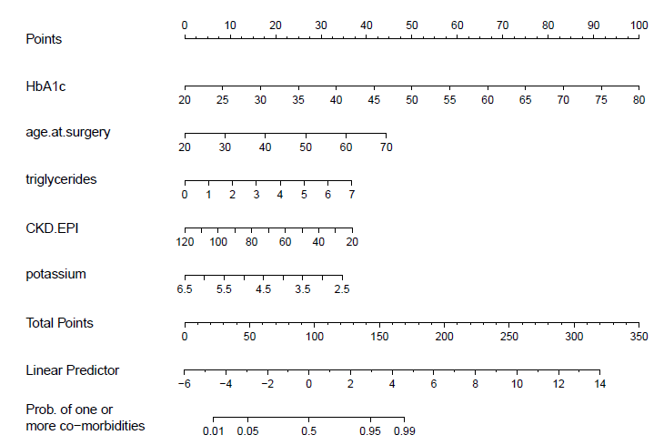
Bariatric
Data set
Previous project
Challenges
  Dropped non
  matching data
  Dropped missing values
  Ignored missing data
Logistic regression
Model nomogram
TPOT’s performance for Biomedical Data

Slide 6
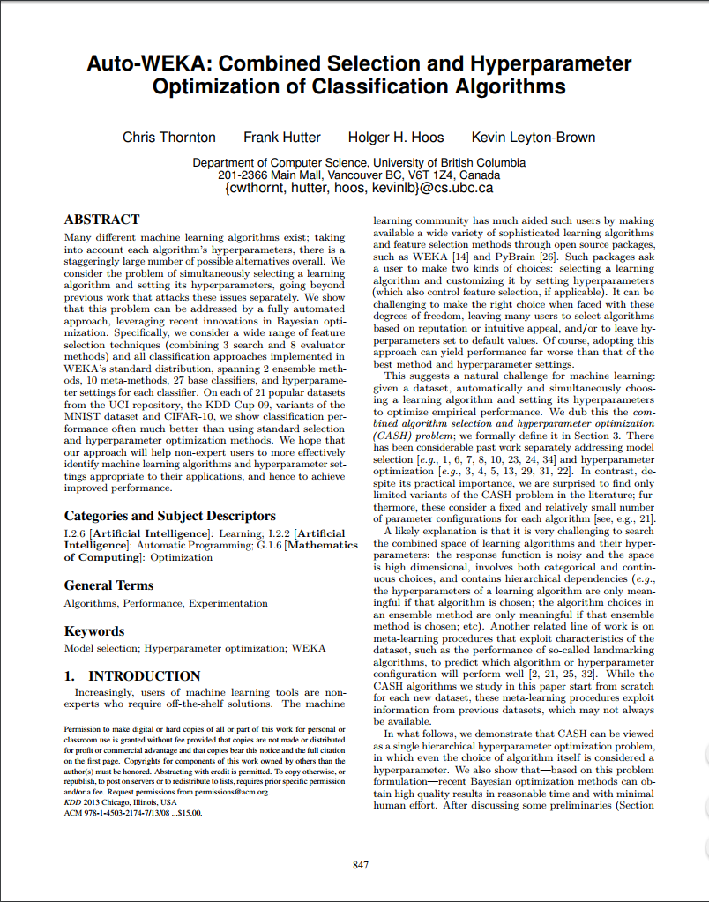
Automated
Machine
Learning
Machine learning pipelines
  Algorithm selection
  Hyperparameter Optimization
  Preprocessing
Combined Algorithm Selection and
Hyperparameter Optimization (CASH)
  Find the best automatically
  Meta-learning approach
  Hyperparameter optimization
  Preprocessing
Auto-WEKA
Thornton, Chris, et al. "Auto-WEKA: Combined selection and hyperparameter optimization of classification algorithms." Proceedings of the 19th ACM SIGKDD international conference on Knowledge discovery and data mining. ACM, 2013.
TPOT’s performance for Biomedical Data

Slide 7

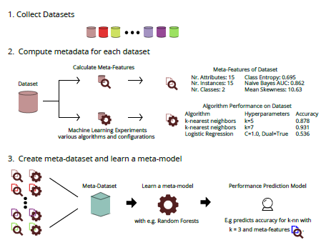
Automated
Machine
Learning
Meta-learning
  Find performance changes
  Time and space constraints
Brazdil, Pavel, et al. "Development of metalearning systems for algorithm recommendation." Metalearning: Applications to Data Mining (2009): 31-59.
TPOT’s performance for Biomedical Data

Slide 8
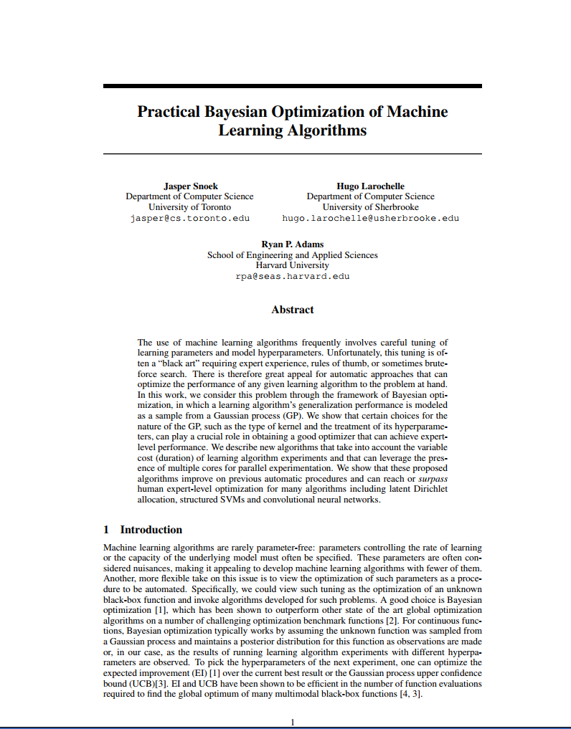
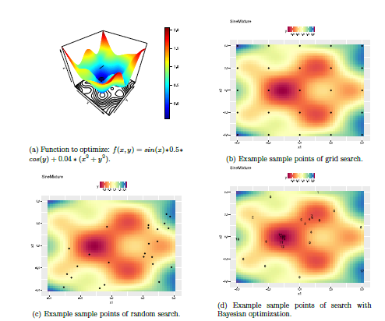
Automated
Machine
Learning
Hyperparameter optimization
    Grid search
    Random search
    Bayesian optimization
Snoek, Jasper, Hugo Larochelle, and Ryan P. Adams. "Practical bayesian optimization of machine learning algorithms." Advances in neural information processing systems. 2012.
TPOT’s performance for Biomedical Data

Slide 9
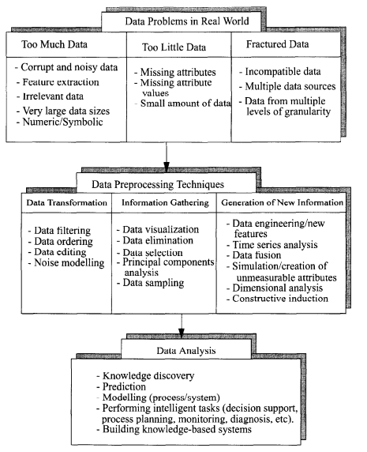
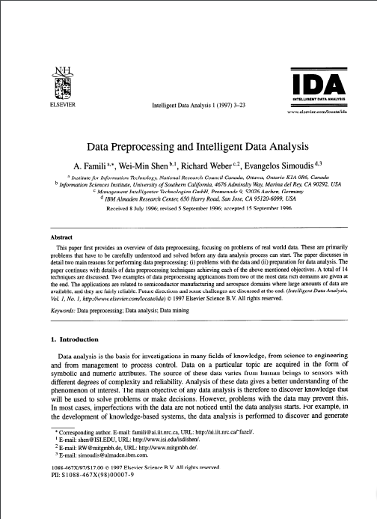
Automated
Machine
Learning
Preprocessing
  Problems
  Techniques
Famili, A., et al. "Data preprocessing and intelligent data analysis." Intelligent data analysis 1.1-4 (1997): 3-23.
TPOT’s performance for Biomedical Data

Slide 10

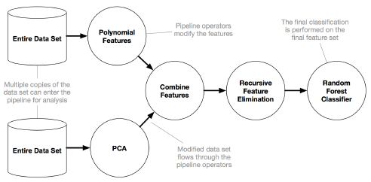
TPOT
Tree-based Pipeline Optimization Tool
  Automated Machine Learning tool
  Scikit-learn
  Evaluation, selection and mutations
Olson, Randal S., et al. "Automating biomedical data science through tree-based pipeline optimization." European Conference on the Applications of Evolutionary Computation. Springer, Cham, 2016.
TPOT’s performance for Biomedical Data

Slide 11
Research
Question
How does TPOT perform on specific biomedical data set problems and how can it be improved?
Hypothesis
  Combining data sets
  Erroneous values
  Missing values
Improvement on missing values
  Extrapolation
  Nearest Neighbours
TPOT’s performance for Biomedical Data

